Slide 1

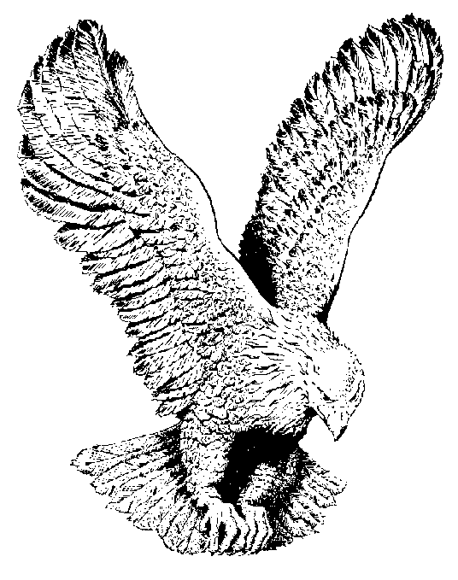
722 HE LOVES ME SO
Just because He loved me so,
Just because He loved me so,
He died on Calvary,
From sin to set me free,
Just because He loved me so.

